Slide 1
x The soft x (palatalized velar fricative)
Notes:
This video will help you to learn to make and describe the soft x, a sound that the letter x makes in Halq’emeylem. It is a kind of a hissy sound in the middle of your mouth.

Slide 2
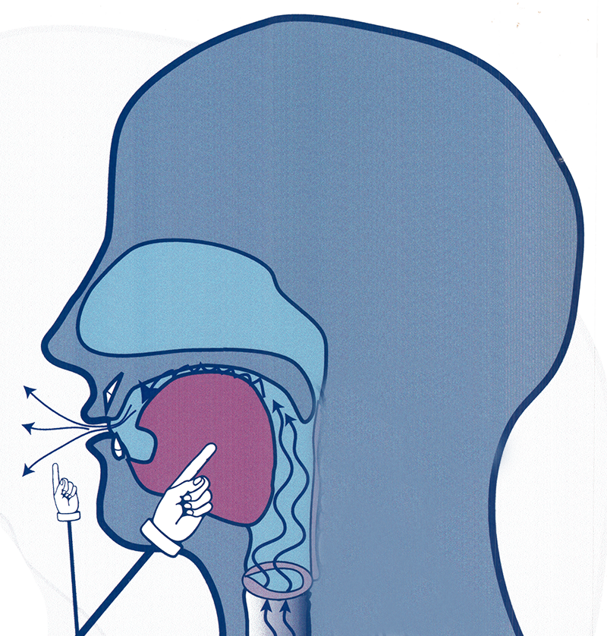
The soft x
Raise tongue towards roof of the mouth, a bit back from where you make sh
Notes:
The Halq’emeylem soft x sound (written with a plain x as the letter) is similar to the sound sh as in English ship; however, for the soft x sound you touch your tongue quite a bit FURTHER BACK, so that your tongue makes contact more n the roof of your mouth, and further towards the back in your mouth
Try touching the body of your tongue right to the roof of your mouth, and make it hissy, and you should be making close to the x sound.
You will sometimes hear a sound like an extra y added after this sound, in certain words. It can be written just with the single letter (small x), but because this sound is very close to where you make the y, you sometimes hear a slight y-sound after the letter.

Slide 3
Example with Elder
xixq’á:m
Notes:
Here is an example of the Elder Siyamiateliyot saying a word with this sound. The word xixq’a:m word means ‘mouth open’, and the small x occurs in it twice.

Slide 4
Careful! x ≠ sh ≠ lh
xókw’em
to bathe
shúkwe
sugar
lhoqw’et
to slap
Notes:
But be careful! The soft x can sound similar to both the sh sound and the hissy-l sound written lh. Here are some example words that might help you to hear the difference. Only the first word starts with the soft x sound.

Slide 5
Careful! x ≠ x
(Stay tuned…)
Notes:
The soft x is also a very different sound from the underlined x. However, we will do a whole video on this later.

Slide 6
Summarizing of the soft-x
A continuous sound with friction
The body of your tongue touches towards the roof of your mouth, a bit towards the back.
It is a different sound from sh, lh, and the underlined x.
Notes:
[can just read the text, expand a bit, as you run through the fades]

