Slide 1
p’ the ‘popped’ (ejective) p
Notes:
This video will help you to learn to make and describe the Halq’emeylem sound p’. This is a ‘popped’ version of the sound /p/, what linguists call an ‘ejective’ version of the sound. You will learn how ‘p is made, and how it is different from the plain p sound.

Slide 2
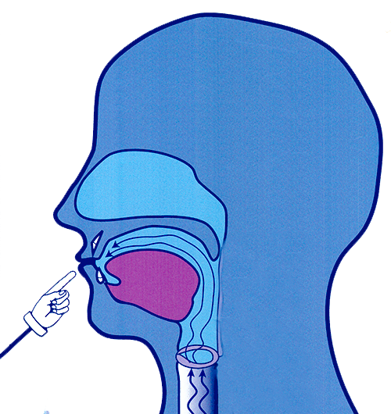
p plain stop
Stop with both lips
Notes:
Let’s start by looking for a moment at how you make the plain p. The plain version is very easy to make: you just stop the airflow for a moment with both lips, and then release it. Linguists call this kind of p a plain stop. The sound occurs in many words in English and in Halq’emeylem, as in English pig or Halq’emeylem pipeho:m for frog.

Slide 3
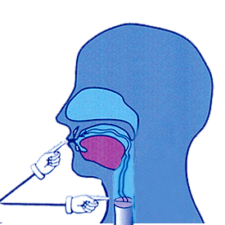
p’ popped version
Step 1/3
Stop with lips
AND
Stop the air in throat
Notes:
The popped of p—what linguists called an ‘ejective stop’—is a lot more complicated. The first step in making this sound is to stop the air in TWO places in your mouth: you stop the air with both lips, as for p, but you ALSO make a catch-in-the-throat sound, also known as the glottal stop. At first you just hold both those closed at the same time.

Slide 4
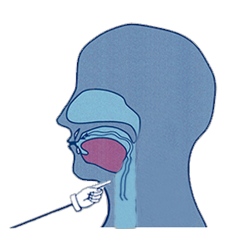
p’ (cont’d.)
Step 2/3
Air trapped in mouth gets compressed!
Now raise your voicebox
Notes:
Now, keeping both your lips and your throat closed, you need to push up your whole voicebox, also known as your larynx, in your throat. The whole thing can move up slightly. Because you have that double closure, the air trapped in your mouth will get compressed by this movement..
Since the trapped air is compressed, it will be at high pressure. [NOTE TO SONJA: CLICK THE LARYNX IN DISPLAY MODE AND IT WILL ANIMATE UPWARDS!!]

Slide 5
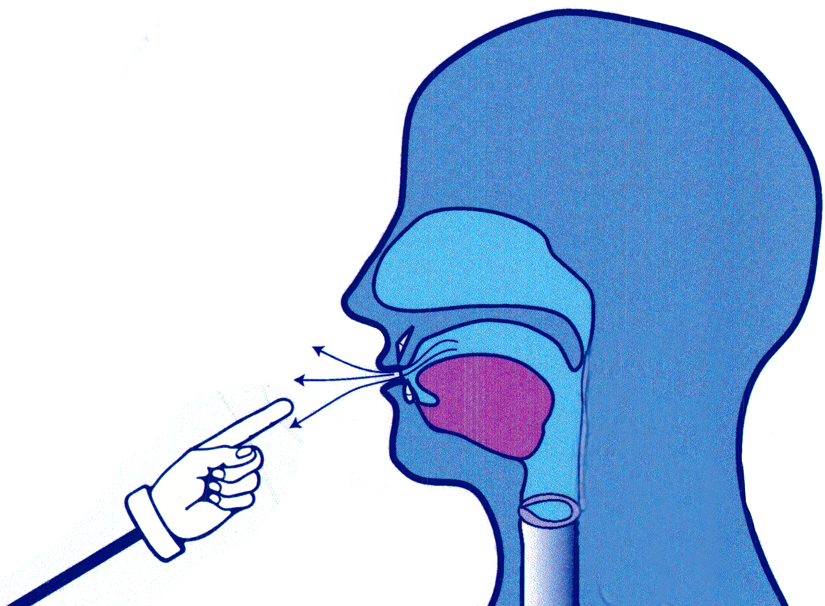
p’ (cont’d.)
Step 3/3
POP!
Notes:
Then, when you open your lips and the high-pressure air will come out with a ‘pop’, as in p’op’etl’em, the word for ‘to smoke’.

Slide 6
Elder Siyamiyateliot demonstrates pronunciation for p’
Notes:
Let’s watch and listen as Elder Siyamiyateliot says the Halq’emeylem word for ‘sewing’, which begins with the popped-p sound. Also known as the ‘ejective’ version of p’.

Slide 7
Careful!
p’ ≠ p
Notes:
You have to be careful to distinguish the popped p from the plain p. They are different sounds in the language, and switching from one to the other can completely change the meaning of a word!

Slide 8
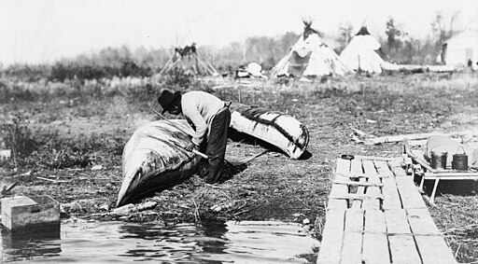
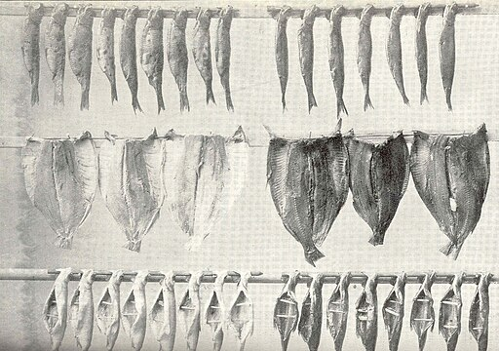
p vs. p’ (example)
p'ákw'et
pákw'et
https://commons.wikimedia.org/wiki/File:Ojibwa_Indian_man_mending_canoe_by_lake_with_teepees_in_1913-_LCCN90710758_(cropped).jpg
Miscellaneous Items in High Demand, PPOC, Library of Congress, Public domain, via Wikimedia CommonsCommons
https://commons.wikimedia.org/wiki/File:FMIB_38902_Manner_of_%27Stringing%27_Certain_Varieties_of_Fish_for_Smoking_at_Washington,_D_C.jpeg
- [[File:FMIB 38902 Manner of 'Stringing' Certain Varieties of Fish for Smoking at Washington, D C.jpeg|FMIB 38902 Manner of 'Stringing' Certain Varieties of Fish for Smoking at Washington, D C]]
--
Notes:
For example,. p’akw’et, with the popped p, means ‘to repair it’ or ‘to fix it’. But pakw’et, with the plain p, means something completely different: it means to heat it up, or to smoke it as for smoking fish. There are many pairs of words like this in Halq’emeylem.

Slide 9
Summarizing p vs. p’
p’ is SIMILAR TO p in that:
But p’ is DIFFERENT from p in that:
Both have short stop at both lips.
The ‘popped’ (‘ejective’) version is much more complex. You have to:
Close at the lips AND in the throat.
Raise your voicebox slightly to pressurize the air trapped in your mouth.
Let the air come out with a ‘pop’!
Notes:
[can just read the text, expand a bit, as you run through the fades]

Slide 10
Side note p’ in other languages
In Hul’q’umin’um’ - p’ (same)
In hən̓q̓əmin̓əm = p̓
Linguistic IPA symbol is / p’ /
Notes:
The popped or ejective p sound occurs in all the other languages in the Salish family In most, languages, including hulq’e’umin’um’, it is written the same as in Halq’emeylem, with the p-apostrophe. In the hən̓q̓əmin̓əm system it is slightly different, because there technically the apostrophe is put right on top of the p-sound.
This sound does not occur in English, so we have no letter for it in English writing. However, BEAT-BOXERS do make ejective stops, too, in their music.

