Slide 1
‘ the ‘glottal stop’ (catch in the throat)
Notes:
This video will help you to learn to make and describe the Halq’emeylem glottal stop sound, which is like a catch in the throat.

Slide 2
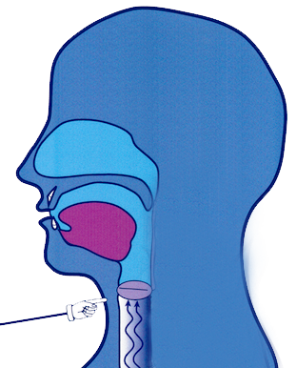
The glottal stop sound ( ‘ )
Stop air briefly in throat, as in English uh oh
Notes:
The glottal stop consonant is a sound where you stop the air briefly in your throat, and then release it. This sound is not written in English, but if you say the word uh oh you will actually automatically produce it twice, before each vowel. Try saying uh oh, and feel the catch in your throat when you do—that is a glottal stop sound.

Slide 3
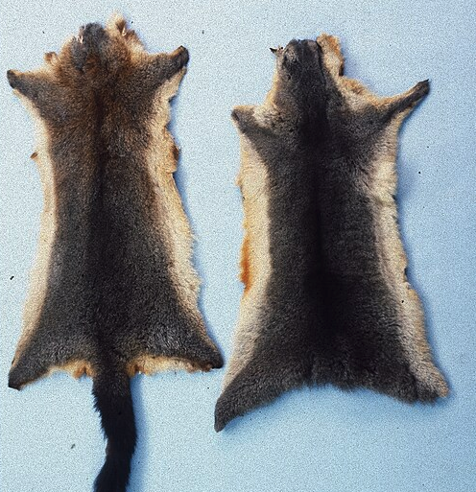
How the glottal stop changes meaning (example)
síkw’
s’íkw’
Mickey Bohnacker, Presse-Fotograf, Frankfurt/Main, Public domain, via Wikimedia Commons - https://commons.wikimedia.org/wiki/File:Trichosurus_vulpecula_(New_Zealand)_fur_skin.jpg
Isaac Jenks isaacjenks, CC0, via Wikimedia Commons - https://commons.wikimedia.org/wiki/File:Lost_in_the_Wilderness_(Unsplash_mEqXkgf34Ew).jpg
Notes:
In English we sometimes automatically produce a glottal stop, as in uh oh, but we never write it because in English the glottal stop is not important for meaning.
But in Halq’emeylem this sound IS written, using the apostrophe for the letter. And in fact you HAVE to write it, because unlike in English in Halq’emeylem just adding of leaving out the glottal stop can totally change the meaning of a word.
For example, compare the words shown here. Sikw’ means ‘to get skinned’. But if you JUST add the glottal stop after the s, written with the apostrophe, then it totally changes the meaning of the word: now it means ‘to get lost’. So the glottal stop is doing a lot of work in changing the meaning, which is why Halq’emeylem needs a letter for it, written with the apostrophe.

Slide 4
Further examples of Elders saying glottal stop
s’úmet
í’i
a’a
s’í:wes
Notes:
Here are some more examples of the glottal stop sound as pronounced by the Elders…s’umet means ‘lazy’, and I’I means ‘cute’.

Slide 5
Note: apostrophe after p is more complex
p’
Same is true for all the stops (p’, t’, k’, q’, kw’ and qw’)
Notes:
When you see the apostrophe after the letter /p/, the pronunciation is more complicated. There IS a glottal stop in these sounds, too, but there is also some other stuff going on that makes the air come out with a ‘pop’.
These popped sounds are called ‘ejectives’, and for now we’ll set them aside and come back in a later video.
Any time you see the apostrophe after another stop (p, t,, k, or q), just be aware that there will be a pop, and we’ll explain in another video how to make that.

Slide 6
Summarizing glottal stop
A stop sound in the throat
You make a ‘catch in the throat’ briefly, and then release it.
It is written with the apostrophe (‘) in Halq’emeylem.
When you see the apostrophe after another stop (like p, or t) then it IS a glottal stop, but there is some more stuff going on, which we will cover in another video.
Notes:
[can just read the text, expand a bit, as you run through the fades]

Slide 7
Side note Glottal stop in other languages
In Hul’q’umi’num’ and written ‘ (same)
In hən̓q̓əmin̓əm̓ written ʔ
In Squamish language written 7.
Linguistic IPA symbol is / ʔ /
Notes:
Let’s end this video with a side note about this same sound in other languages.
The glottal stop occurs as a significant sound in MANY of the world’s languages, including all of the other languages in the Salish family.
In Hul’q’umi’num’ and many other languages it is written with the apostrophe, as in Halq’emeylem.
In hən̓q̓əmin̓əm the same sound is written a question mark, but without the dot.
And in the Squamish language this same sound is written with the number 7.
The linguistic IPA symbol is also the question mark without the dot, as the hən̓q̓əmin̓əm system is quite close to the IPA.

